Slide 1
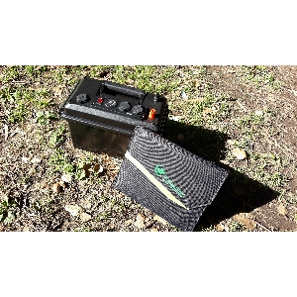
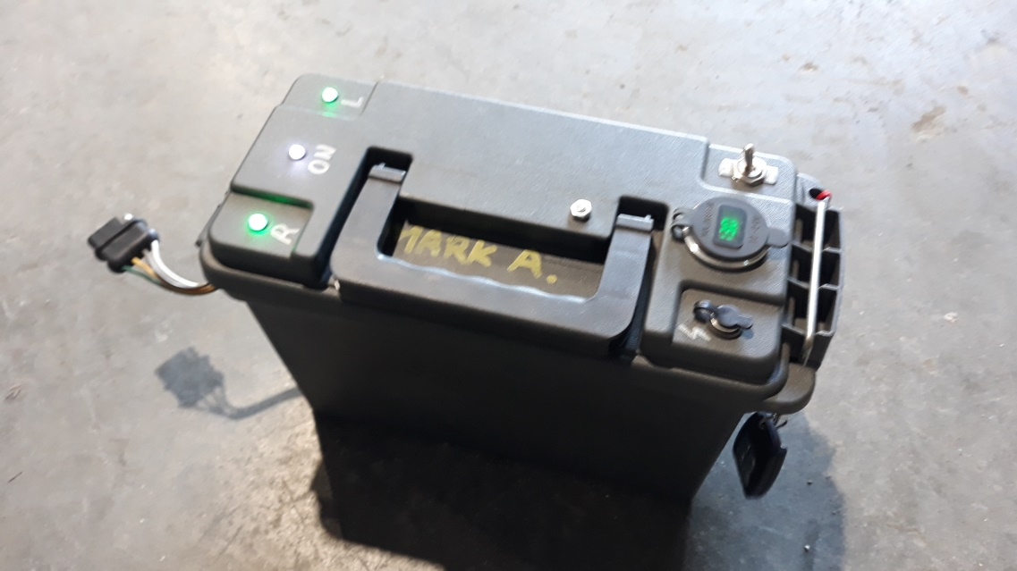
Go Box & Trailer Box
By Mark Arlotti, KM6AHY

Slide 2
Go Box & Solar Panel

Slide 3
Go Box with added Charge Controller

Slide 4
12V/24V, 20A Solar Charge Controller
SC-122420JUD
Bioenno Power $49.99

Slide 6
Added Input Bulkhead & Switch

Slide 8
28Watt Foldable Solar Panel
BSP-28
Bioenno Power $104.99

Slide 9
Powerwerx PWRbox
$100 - $120
Powerwerx.com

Slide 12
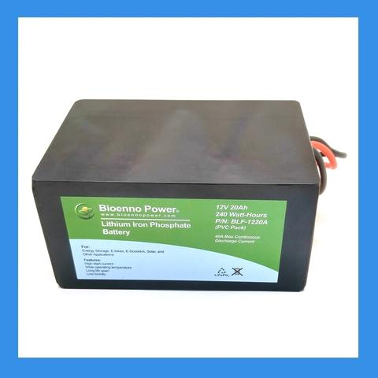
Bioenno Power
12V 12Ah LFP
$124.99
12V 20Ah LFP
$192.99
PVC, BLF-1212A
Lithium Iron Phosphate
batteries
PVC, BLF-1220A

Slide 13
Approximant Pricing
PWRbox: $120
Solar Charge Controller: $50
Solar Panel 28W: $105
Switch & Connecters: $20
12V 12Ah Battery: $125
12V 20Ah Battery: $193

Slide 14
Trailer Light Box

Slide 16
Geekcreit® 12V 4CH Channel 433Mhz Wireless Remote Control Switch With 2 Transmitters

Slide 17
Towable Air Compressor
Trailer Box connected to a trailer

Slide 18
Video Time

Slide 19
The End
Questions?

